Slide 1
Welcome to CS4141 PSLG!
With Robert and Jakub

Slide 2

Java while loop
The while loop loops through a block of code as long as a specified condition is true:
Syntax:
while (condition) {
// code block to be executed
}
Example:
int i = 0;
while (i < 5) {
System.out.println(i);
i++;
}

Slide 3
Java do/while loop
The do/while loop is a variant of the while loop. This loop will execute the code block once, before checking if the condition is true, then it will repeat the loop as long as the condition is true.
Syntax:
do {
// code block to be executed
}
while (condition);
Example:
int i = 0;
do {
System.out.println(i);
i++;
}
while (i < 5);

Slide 4
Problem 1
Write a Java program to:
Determine and print the number of digits in the number 9987654321.
E.g., 9987654321 has 10 digits

Slide 5
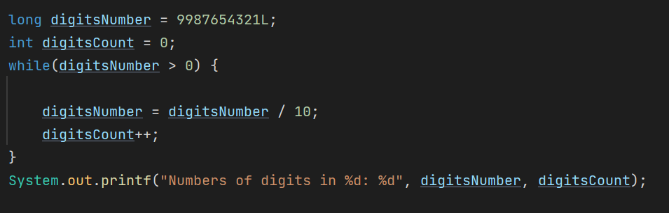
Answer:

Slide 6

Problem 2
Write a Java program to:
find the value of one number raised to the power of another. (Do not use the Java built-in method) E.g., m=2; n=3; result = $m^{n}$ = $2^{3}$ = 8​

Slide 7
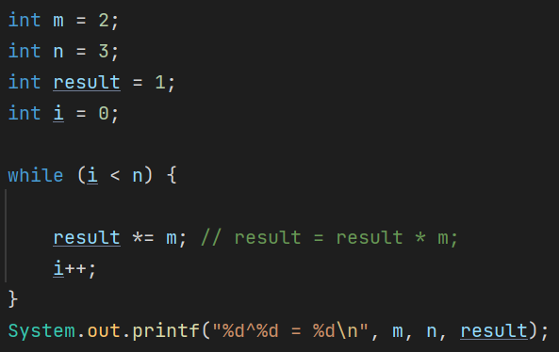
Answer:

Slide 8
Problem 3
Write a Java program to:
calculate the product of numbers from 1 to n.​ E.g., 1*2*3*…*n

Slide 9
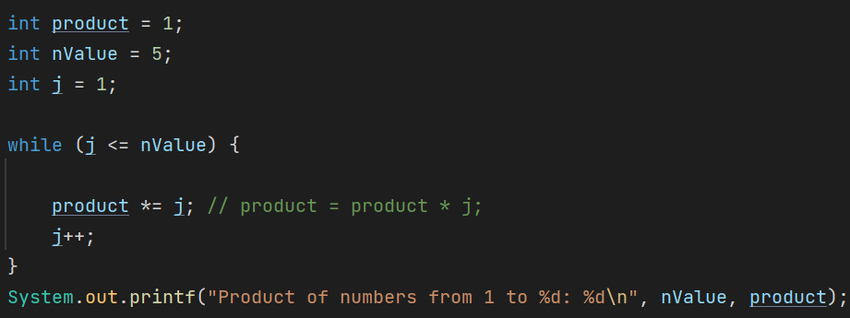
Answer:

Slide 10
Problem 4
Write a Java program to:
print the sum of all odd numbers from 1 to 50.​ E.g., 1+3+5,+7+9…….45+47+49.

Slide 11
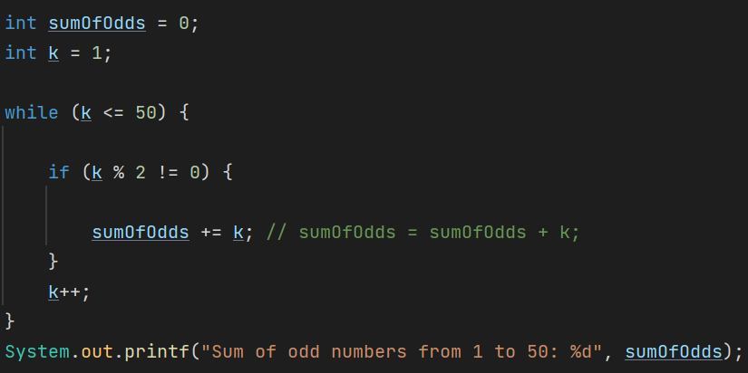
Answer:

Slide 12
Thank you for coming!

